Slide 1
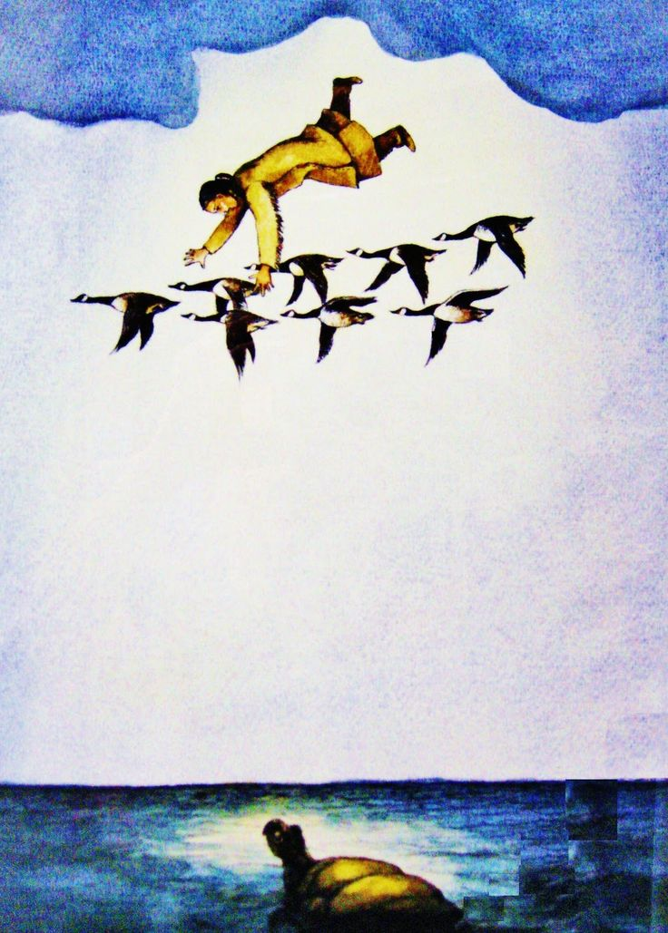
Using Indigenous Legends for Integrative Learning: “Sky Woman Falling” Meets the Internet
Dr. Maya J. Lo Bello
Department of Foreign Languages and Literature
Eötvös Loránd University, Faculty of Primary and Preschool Education

Slide 2
Teachers’ Training: Critical Pedagogy and Cultural Sensitization
“Reading the world always precedes reading the word, and reading the word implies continually reading the world.” Paolo Freire
Epistemic injustice →→→ Hermeneutical injustice (Miranda Fricker)
Stereotypes →→ Ethnotypes →→ The Other
The Gaze →→ Objectification, sexualization, orientalization (Sander L. Gilman)

Slide 3
Integrative Learning
https://www.ithaca.edu/academics/integrative-core-curriculum/what-integrative-learning
"Integrative learning is the process of making connections among concepts and experiences so that information and skills can be applied to novel and complex issues or challenges.”
Aims of Integrative Core Curriculum (for university students at Ithaca College, NY, USA):
To produce graduates who can:
address a topic, issue, problem area, or human challenge using a combination of concepts, theories, and/or methods from multiple perspectives or fields of study,
apply concepts, theories, methods, or skills to analyze new questions or complex problems, and
engage in and communicate self-reflection about their learning in the Integrative Core Curriculum

Slide 4
Integrative Learning in the EFL Literature Classroom
Main aim:
To integrate culture!
Methods:
Use literary texts to expose students to works that can be approached from many fields (cultural studies, music, language, science, art, history, sociology)
Find sources that recreate the world of the text: Youtube and the Internet are the most convenient, fastest ways to accomplish this.
Project-based methods; different teacher mentality: I am not the authority, I am the one who poses questions. We search for answers to our questions together; the students are the detectives or explorers; we assess what is “right” or “wrong” together; grades given on personal effort, contribution, participation rather than test scores

Slide 5
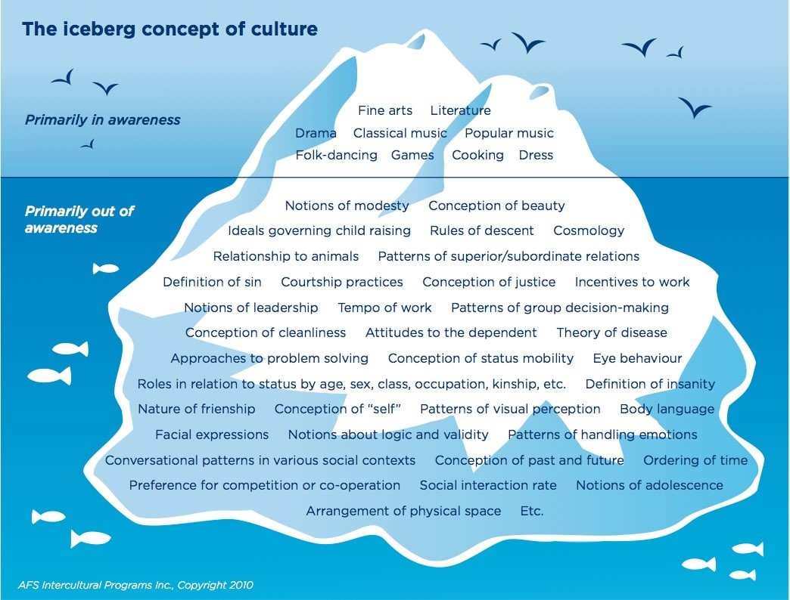
Basic Ground Rules
Need to discuss the meaning of culture and compare concepts to our own culture (cultural iceberg: Source: https://bit.ly/3DH9zhE )
Establish common rules for talking about cultures: what is a respectful way to approach different customs, habits, appearance, etc.? (What are stereotypes?)
Discuss need to fact check sources, always look for who is speaking, where is this person from, what is the quality of this source? (Critical thinking, early research methods)

Slide 6
Cultural Education and Young Learners
Young learners are exposed to many cultures through the Internet
Young learners (fourth grade) are generally tech savvy
Young learners need emotional guidance and support in asking questions (from a teacher)
Brings the language classroom alive, develops language usage within its authentic context
Children’s stories and films already contain cultural stereotypes about the "exotic”: Pocahontas (1995) = Native American culture; Lilo and Stitch = Samoan culture; The Lion King = African? culture; Mulan = Chinese culture; Aladdin = Arab culture; Coco = Mexican culture; Encanto = Colombian culture

Slide 7
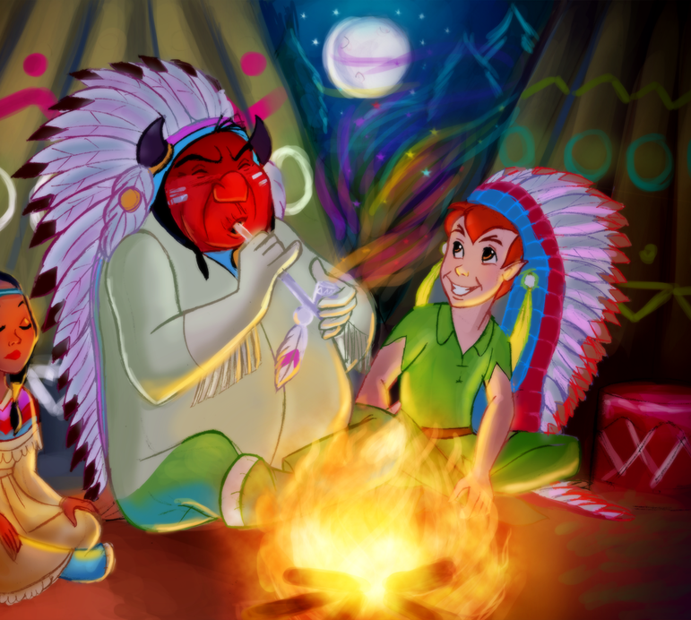
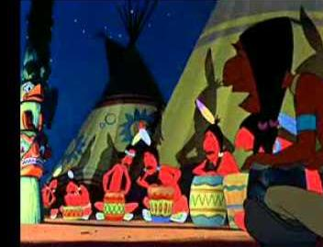
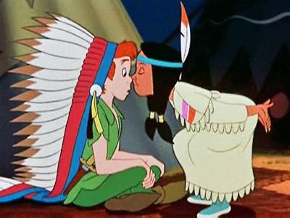
“What Makes the Red Man Red?”
https://www.youtube.com/watch?v=f7yE8TKUB_M&t=23s&ab_channel=peterpan3401

Slide 8
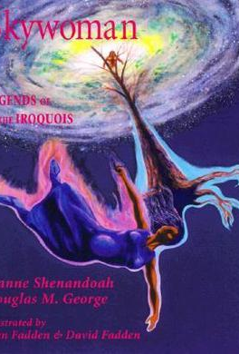
“Sky Woman Falling”: Algonquian legend (Northeast Indigenous Tribes, USA)
Who is telling the story? Why is the tribal affiliation included?
What is the difference between hearing it and reading it? (Children’s book written by Joanne Shenandoah, Douglas M. George-Kanentiio; illustrated by John Fadden) Can investigate these authors and artists!
https://www.youtube.com/watch?v=SZ4C3YDp1o4&ab_channel=Bmaawangsekwe
https://www.youtube.com/watch?v=gRgWTs9FKIs&ab_channel=VoicesfromtheGatheringPlace

Slide 9
Ideas for projects
The students identify what is unknown, strange, unusual, unfamiliar
    Do you know what a loon is? Have you ever seen an otter? (Science)
    Do you know how seeds grow? (Science)
    How would your council help a stranger? (Ethics)
    Can you find Turtle Island on a map? Can you find the Iroquois Nation on a map? Do you know where the Ojibwe live? (Geography)
    How do you think Sky Woman danced? (Dance/PE)
    What is the music like in this video? Can you find more examples? (Music)
    What do you think the Tree of Life looks like? (Art, Ethnography , Hungarian culture)
    Is this the only version of this story? Can I find others on the Internet? Which one is the best? Have the other groups examined their sources? (IT, critical thinking)
    What words are unfamiliar to you in this story? (English)
    What stories have you heard from your family? What stories do you know about how the world began? (Family history, oral history, religion, world/cultural views)

Slide 10
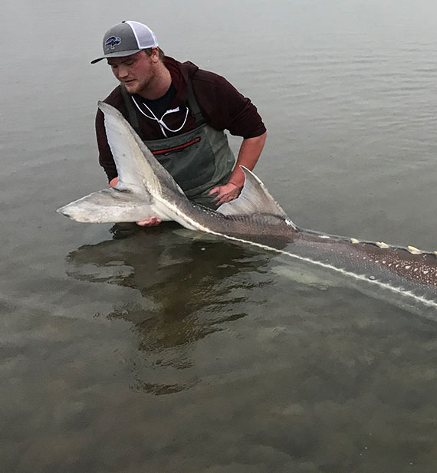
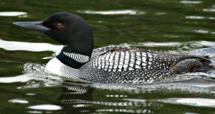
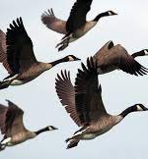
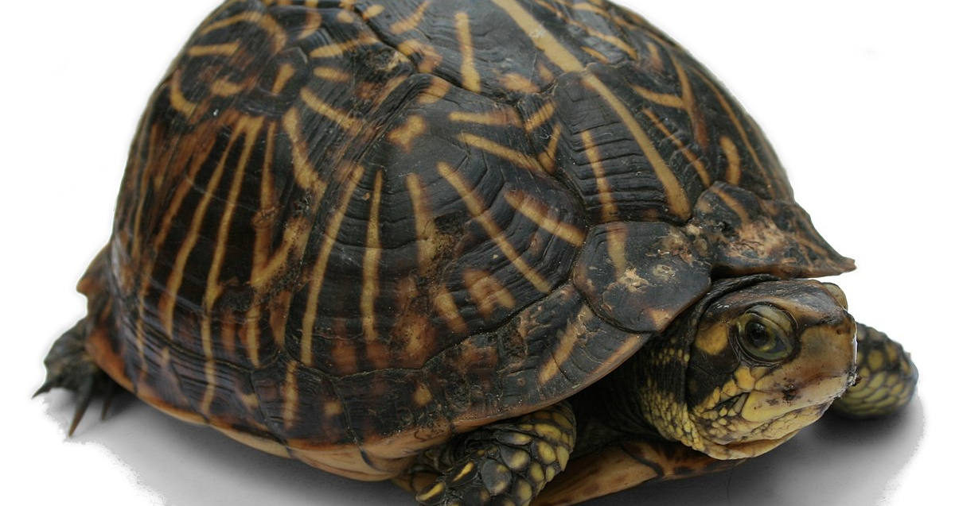
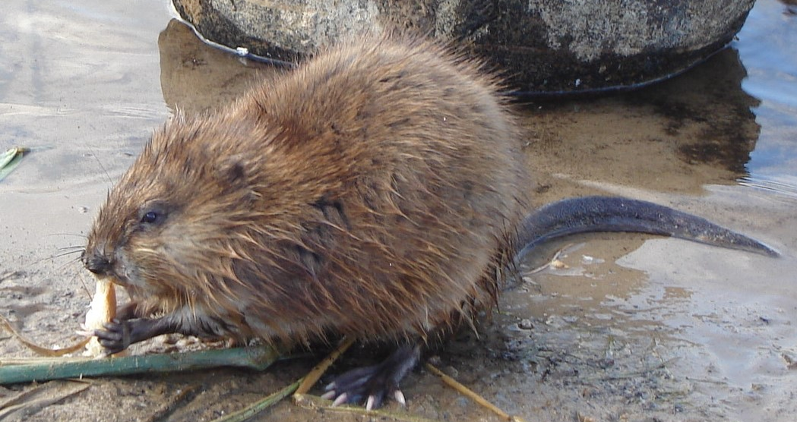
North American Animals: Who did what in this story? https://www.youtube.com/watch?v=sVJHQo6yQr0&ab_channel=DorenEris

